Slide 1
Estimating the Access Function of Health Insurance
Christopher T. Robertson

Slide 2
Background
Health insurance increases health spending
Evidence, including RAND HIE, compares insurance with no (or less) insurance
Standard story
Theory: “Moral hazard” – I get the product, you pay for it.
Waste: patient consumes care that is not worth its price.
Law and contracts partially solve by making health insurance incomplete – cost-sharing (copays, deductibles, coinsurance)

Slide 3
Nyman’s Story
Aggregate health spending is driven by very expensive care, far beyond patient’s ability to pay out of pocket (e.g., $80,000 cancer drug)
Insurance expands purchasing power, by redistributing from healthy to sick
Marginal purchases caused by insurance not necessarily waste
Cost-sharing can undermine this access-function of insurance
But traditional moral hazard still exists too. But we cannot observe and measure it by simply examining the increased spending due to insurance.

Slide 4
Research Question
How much of increased spending due to health insurance is waste (which law and contracts should target), versus access (which law and contracts should facilitate)?
What is the counterfactual for the access function?
Uninsurance (as in standard story), and
Fungible full insurance (indemnity)

Slide 5
Design
Blinded Vignette-Based Online Randomized Experiment
Clinical scenario developed by physician for prior research – use of “Bucarin” as an additional chemotherapy for colon cancer
Vignettes interrupted by writing task and respondents explained decisions – engagement + qualitative data
N=600 from Mturk
Randomized (2x3)
high-value (on label) versus low-value (off-label) proposed treatment
uninsured, traditional insurance (no copay), insured with indemnity

Slide 6
Base Case
Please imagine yourself in the following situation.
Over the last month, blood has occasionally appeared in your stool, when you used the bathroom. You make an appointment to see a doctor. After receiving normal results from some tests, the doctor suggests a colonoscopy to determine the cause of the bleeding. The test reveals a mass, and so a biopsy is performed.
The biopsy confirms that the bleeding is caused by adenocarcinoma of the colon. Your oncologist performs further tests to determine if the cancer has spread beyond the colon. The tests, including a CT scan, are negative. Therefore, surgery is scheduled to remove the tumor, and hopefully provide a complete cure.
However, the surgeons discover that the tumor has spread past the wall of the colon and infected two small lymph nodes.
These findings substantially change the prognosis. It is now much less likely that surgery alone will result in a full recovery. …
Hence, the oncologist tells you that chemotherapy is the standard treatment. The oncologist estimates that the chance of survival from this cancer, with the standard chemotherapy treatment, is 70%. The doctor is called away, and will be back shortly. [writing task]
The doctor suggests that another drug, Bucarin, could be added to the standard chemotherapy regimen to improve the chances for a cure. [high-low manipulation]
Furthermore, Bucarin also has potential side effects, including excessive bleeding and high blood pressure. Your oncologist recommends Bucarin despite these limits, but he explains that many other oncologists do not use Bucarin for colon cancer. The choice is yours. [insurance manipulation]

Slide 7
Manipulations
Type of Insurance
[INDEMNITY INSURANCE] In this case, Bucarin will cost an additional $80,000. Thankfully you have full health insurance, and you have already met your annual deductible. Your insurance company also has a unique program, in which they cover special drugs with a cash payment, called an indemnity (similar to home owners insurance or car insurance). Because your physician has indicated that you are a candidate for Bucarin, you receive a $80,000 cash payment from your insurance company. You receive the money regardless of whether you decide to take the Bucarin. You decide whether you spend the cash on the Bucarin treatment or instead keep the money for whatever other purposes you may choose. In deciding, please be realistic.
[TRADITIONAL INSURANCE] In this case, Bucarin will cost an additional $80,000. Thankfully you have full health insurance, and you have already met your annual deductible, so there is no additional cost to you out of pocket, if you choose to take the Bucarin treatment. In deciding, please be realistic.
[UNINSURED] In this case, Bucarin will cost an additional $80,000. Please imagine that you currently do not have health insurance, however you do have the same amount of wealth and credit that you actually have in the real world (the amount you provided in your answer above). So, only if you have enough money available, you can pay for the Bucarin yourself. Please consider, however, other things you may prefer to do with the money. Please be realistic.
Quality of Treatment
[LOW VALUE] Bucarin has been approved by the Food and Drug Administration, in combination with standard chemotherapy, to treat patients suffering from lung and pancreatic cancers -- not for colon cancer, which you have. However, some oncologists use Bucarin “off-label” for colon cancer too. The advantages of Bucarin for colon cancer have not proven to be effective.
[HIGH VALUE] Bucarin has been approved by the Food and Drug Administration, in combination with standard chemotherapy, to treat patients suffering from colon cancer, which you have. That means that the advantages of Bucarin for colon cancer have been proven to be effective.

Slide 8
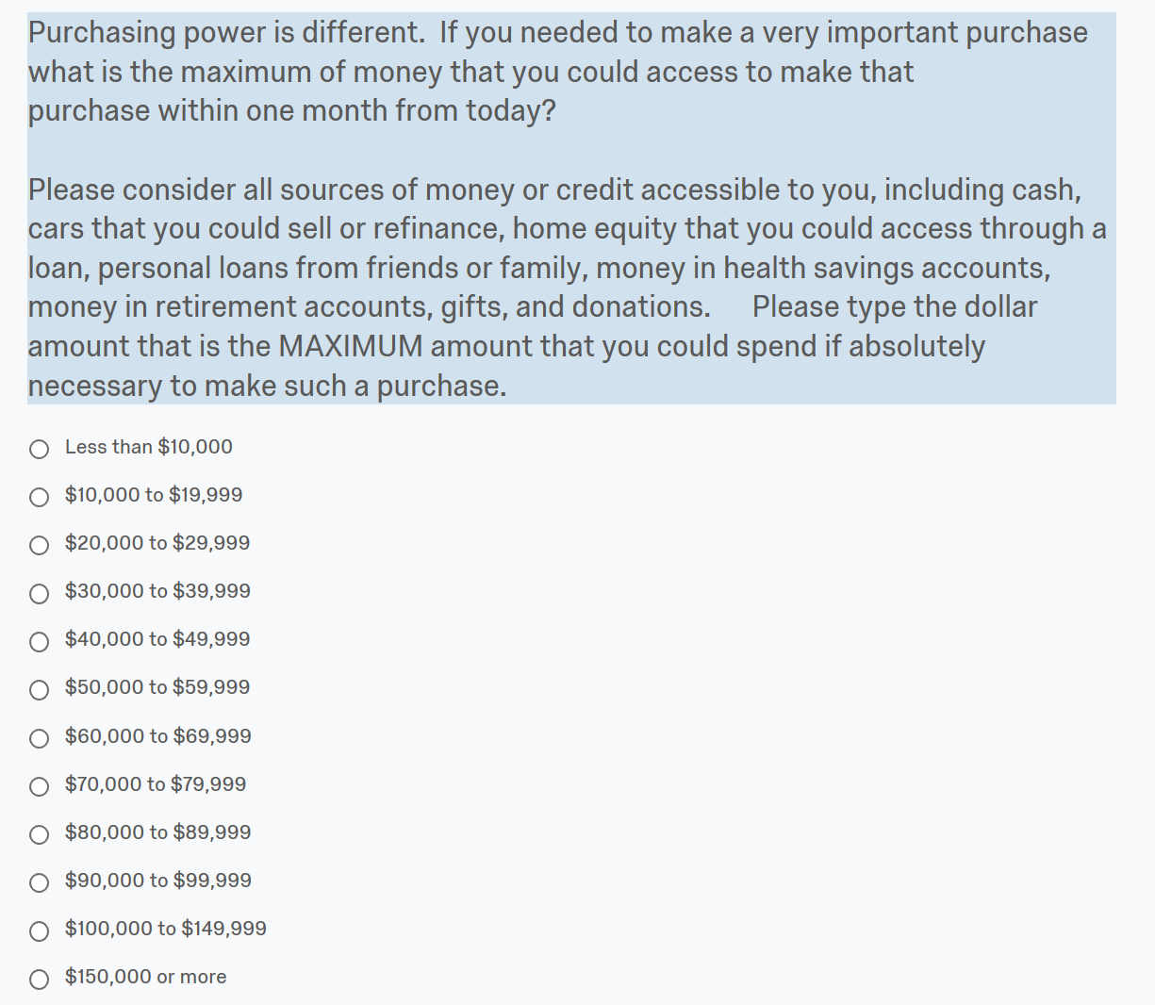
Maximum Purchasing Power

Slide 9
Income and Purchasing Power

Slide 10
Income and MaximumPurchasing Power
13.6% of respondents could afford $80k drug out of pocket

Slide 12
Moral Hazard (not significant)
Access
Risk Spreading

Slide 13
Discussion
Significant moral hazard is not detectable at n=600
Access function of insurance is 4x the size of moral hazard (if any)
So be careful that law and policy throw out baby with bathwater
Disclosure of off-label status of drug makes big difference
Patients may self-ration even with insurance
How often do physicians make that disclosure?
Is informed consent law a tool to reduce wasteful spending?

Slide 14
Further analyses
Explore optimism bias with pre-post questions as to purchasing power
Manipulation check to test understanding of assigned insurance type
Multivariate regressions with demographics, including real insurance status
Code qualitative data

Slide 15
How to Extend?
Try to replicate with another clinical scenario (stent) and another population?
Try a range of prices?
Hypotheticals with real patients considering treatment?
Field experiment of indemnity insurance?

Slide 16
Thanks
Prior collaborators Victor Laurion, Keith Joiner, David Yokum, Nimish Sheth

